Slide 1

Introducing HomeAway Explore
Kushantha Attanayake, David Bush, Min Han,
Johnathon Love, Kiankris Villagonzalo

Slide 2

Our Design Problem
How do we draw users to HomeAway even when they are not actively planning a trip?

Slide 3
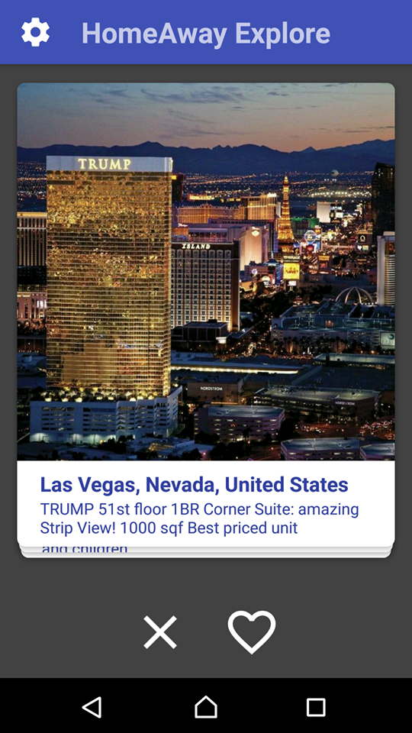

Meet HomeAway Explore
Place your screenshot here
HomeAway Explore brings discovering the perfect rental getaway to users in an all new addictive swiping experience

Slide 4
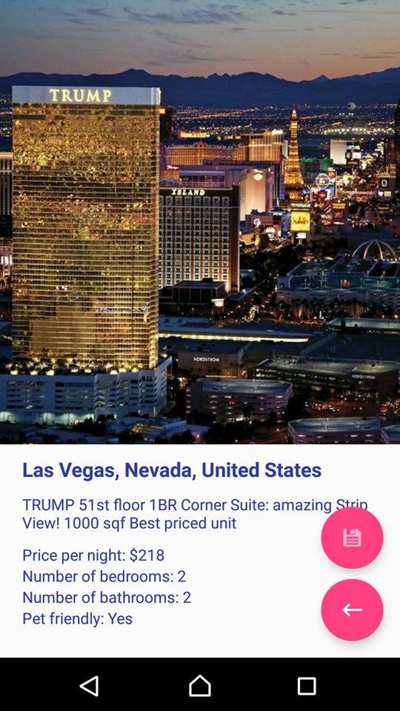
Implemented Features
Place your screenshot here
Intuitive Navigation
Filtered Listing Results
Save Favorited Properties
Easy Booking

Slide 5
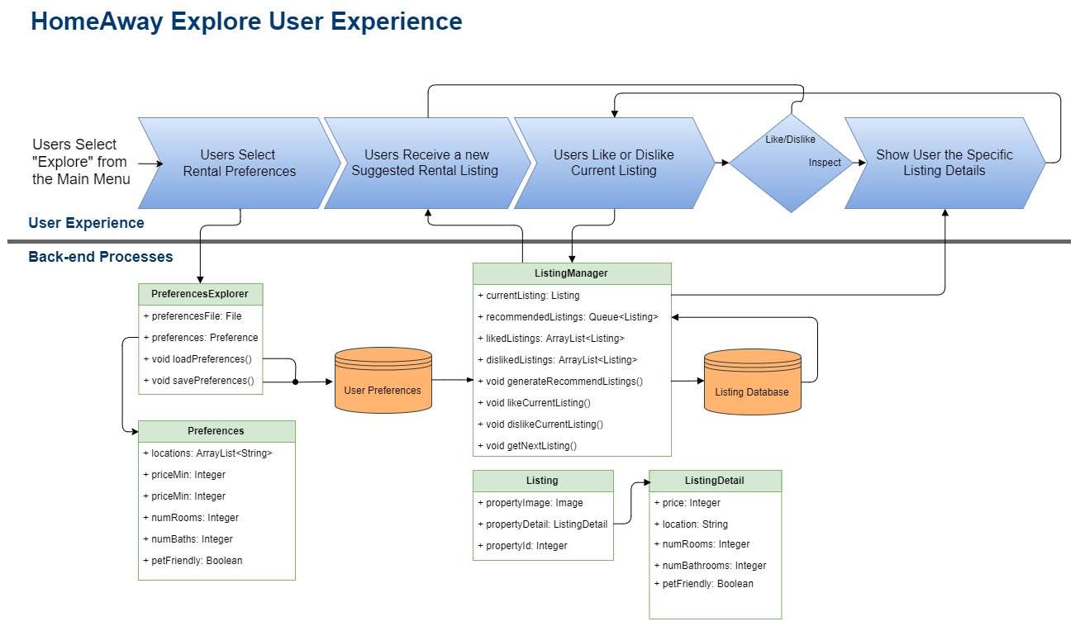

The User Experience

Slide 6
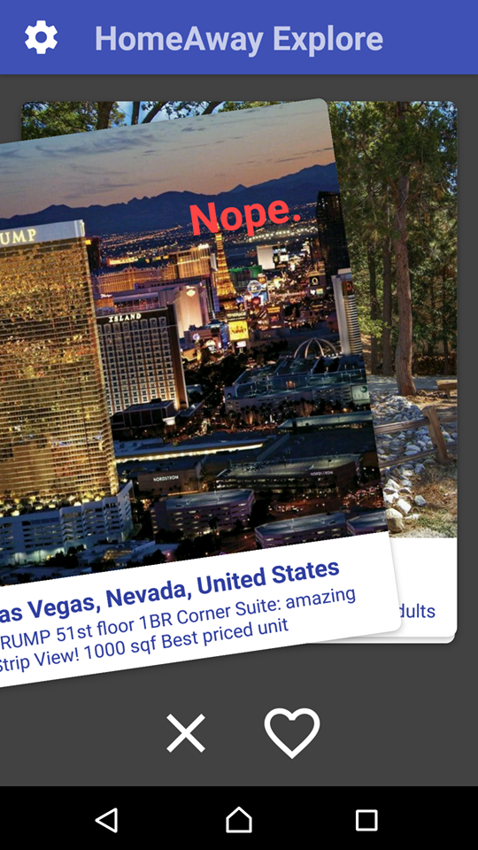

Planned Features
Place your screenshot here
Browse Properties in VR or 360 Pictures
Machine Learning for Smarter Listing Results
HomeAway Database and App Integration

Slide 7
Thanks!
Any questions ?
You can find our repo at
github.com/kiankris/HomeAwayHackathon

